Slide 1
FRC Java API
Who what in the where now

Slide 2
Refresher
Objects are the basic building blocks
They have State and Behavior
State = variables Behavior = methods
Variables
Can be instances of objects
They have type ← defines how the data in it is stored and how you can manipulate it

Slide 3
The FRC Java Setup
Software
Java SE Dev. Kit
This guy knows what to do with the java code
NetBeans
The editor we type our code into
SunSPOT Java SDK for FRC (includes WPILib)
These are all the helper methods that are provided – free of charge

Slide 4

Where to go for documentation
Javadoc! – verrry niiiice
Auto generated documentation from your comments
See the Team2168 tutorial for more info
http://team2168.org/index.php/tutorials/89-frc-java-api-documentation?catid=54%3Aprogramming
There’s a good PDF if that’s more your style:
“WPI Robotics Library User’s Guide”
http://first.wpi.edu/Images/CMS/First/WPI_Robotics_Library_Users_Guide.pdf

Slide 5

THE DEEP END
Lets get into it

Slide 6
Default Java Programs
Starting a project – Three choices
Simple Robot
Code runs sequentially from start to finish
Simple / limited
Iterative Robot
Methods corresponding to game mode get called repeatedly/automatically
More complex / versatile
Command based robot
An extension of the iterative robot project
Helps organize code and separate software/hardware development

Slide 7
SimpleRobot
public class MyRobot extends SimpleRobot {
/**
* This function is called once each time the robot enters autonomous mode.
*/
public void autonomous() {
// put auto code here
}
/**
* This function is called once each time the robot enters operator control.
*/
public void operatorControl() {
//put teleop code here
}
}
Each of these methods
only gets called once
This setup is going to need a lot of loops and wait statements to get stuff done.

Slide 8
IterativeRobot
public class MyRobot extends IterativeRobot {
/**
* This function is run when the robot is first started up and should be
* used for any initialization code.
*/
public void robotInit() {
// inintialize variable here – like begin.vi in labview
}
/**
* This function is called periodically during autonomous
*/
public void autonomousPeriodic() {
// auto code goes here
}
/**
* This function is called periodically during operator control
*/
public void teleopPeriodic() {
//teleop code goes here
}
}
Each of these methods are called w/ driver station update (~50Hz)
Contents should be quickly processed.
This setup lends itself to state machine style design

Slide 9
Command based robot
http://firstforge.wpi.edu/sf/go/doc1297

Slide 10
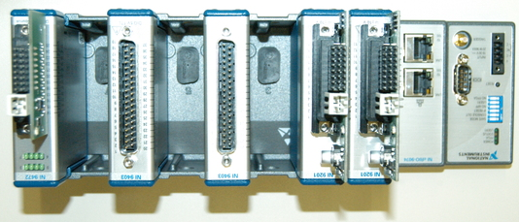
Inputs/Outputs
The cRIO has a bunch of slots for modules
The modules allow for different types of inputs and outputs to interface with the system.
Inputs tell us information about the world
Sensors
Commands
Outputs allow us to interact with the world
Motors
Relays
Solenoids

Slide 11
Inputs: Joystick
Joystick data read by Driver Station
Fed to robot over Eternet
Helper class: Joystick
edu.wpi.first.wpilibj.Joystick

Slide 12
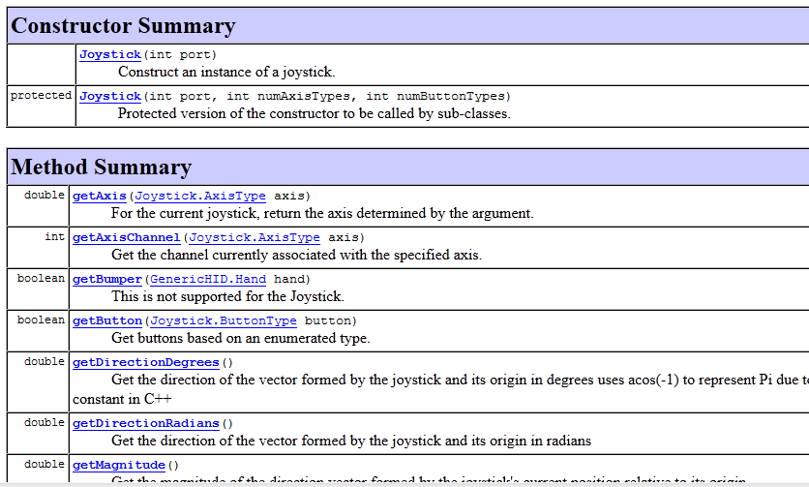
Some details from Javadoc

Slide 13
Inputs: Gyroscope
Measures rate of rotation relative to starting position
Measured through analog input channel
Helper class:
edu.wpi.first.wpilibj.Gyro

Slide 14
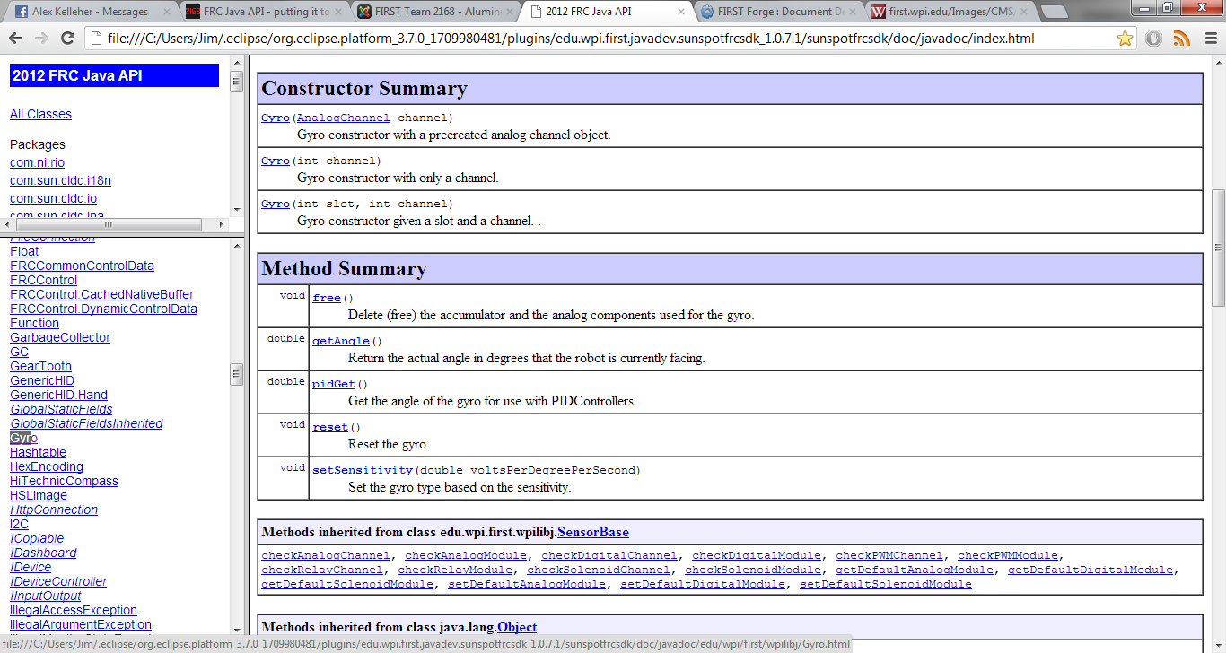
Some details from Javadoc

Slide 15
Outputs (e.g. Motor)
Motors are controlled over PWM/CAN through a controller
Helper class for running the controllers: RobotDrive
Out of the box implementations for Arcade, Tank, etc.
edu.wpi.first.wpilibj.RobotDrive

Slide 16
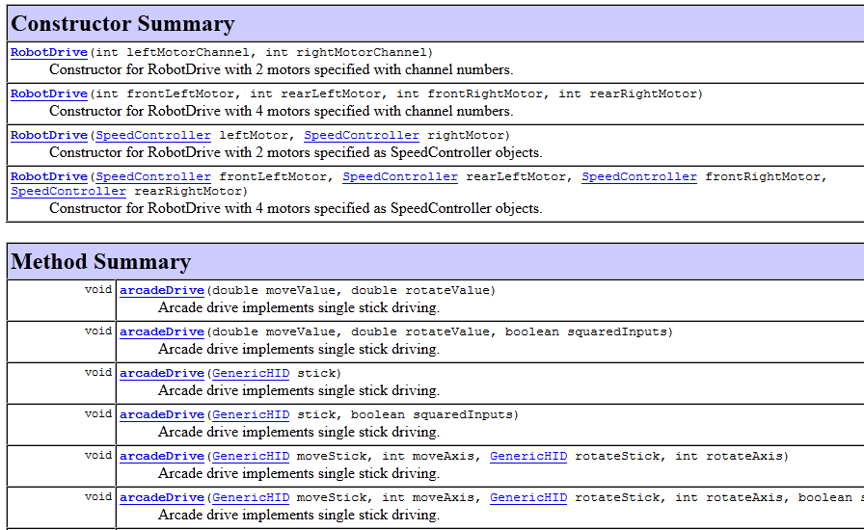
Some details from Javadoc

Slide 17
A simple obstacle avoidance bot
Autonomous
Use a Gyro and Ultrasonic sensor to autonomously drive around without hitting anything
Use the following algorithm
If you see a wall, turn 180 degrees
otherwise drive straight
Teleoperated
Use joystick inputs, adjusted to improve operator control

